Slide 1

Credit Card Fraud Detection—
Exploratory
Data Analysis
Presented by Sakshi Sahu
Data Science Intern at HackVeda
Dataset—Credit Card Fraud Detection
Libraries: Numpy , Pandas, Seaborn, Matplotlib

Slide 2
Table Of Contents
Hook Story
Agenda
Our Mission
Dataset Snapshot
Data Refinement
Univariate Analysis
Bivariate Analysis
Demonstration
Key Insights
Addressing the Elephant in the Room
Conclusion
Question & Answer

Slide 3

Hook story
“Imagine waking up one morning to find multiple charges on your credit card—for items you never purchased. Maybe it’s a late-night order from another country or a series of small transactions adding up to a huge amount. This is the reality of credit card fraud, a problem that costs banks and customers billions every year.
What makes it even more challenging is that fraud is extremely rare—less than 0.2% of all transactions—but the impact of just one missed case can be devastating.
That’s why today, I’ll take you through my exploratory data analysis of credit card transactions—uncovering patterns, anomalies, and insights that can help us detect fraud. It’s too late.”

Slide 4
Agenda: Navigating the Data Landscape
01
02
03
Setting the Stage
Data at a Glance
Deep Dive into Data
Understanding the objectives and scope of our analysis.
An overview of the dataset's structure and initial observations.
Exploring cleaning, preprocessing, and analytical techniques.
04
05
Key Discoveries & Challenges
Path Forward
Highlighting insights and obstacles encountered during EDA.
Summarising findings and outlining next steps for model development.

Slide 5




Our Mission: Core Objectives of This Analysis
Dataset Comprehension
Feature Identification
To deeply understand the distribution, inherent characteristics, and underlying structure of the transaction dataset.
To pinpoint critical features and discern the intricate relationships between them, vital for predictive modeling.
Anomaly Detection
Modeling Preparation
To rigorously detect and catalogue any anomalies or outliers present in the data, which often signify fraudulent activity.
To meticulously prepare and refine the dataset, making it robust and ready for advanced modeling, including fraud detection and customer segmentation.

Slide 6

Dataset Snapshot: Unpacking the Raw Data
Our dataset comprises 300,000 rows and 31 features, offering a comprehensive view of credit card transactions. Key variables include Transaction Amount, Time, and anonymised features (V1-V28), alongside a critical Fraud label.
Due to the sensitive nature of financial data, several features have undergone Principal Component Analysis (PCA) for confidentiality, ensuring data privacy without compromising analytical utility. This transformation allows us to analyse complex relationships safely and effectively.

Slide 7
Data Refinement: The Cleaning & Preprocessing Journey
Before diving into insights, rigorous data cleaning and preprocessing were essential. This stage ensured data quality and consistency, laying a solid foundation for reliable analysis.
1
2
Missing Values
Duplicate Entries
Thorough checks for missing values, with appropriate imputation strategies applied to maintain data integrity.
Identification and removal of duplicate transaction records to prevent bias and ensure data uniqueness.
3
4
Outlier Detection
Data Type Consistency
Advanced techniques were used to detect and handle outliers, crucial for preventing skewed analytical results.
Ensuring all features adhered to their correct data types for accurate computations and visualisations.

Slide 8
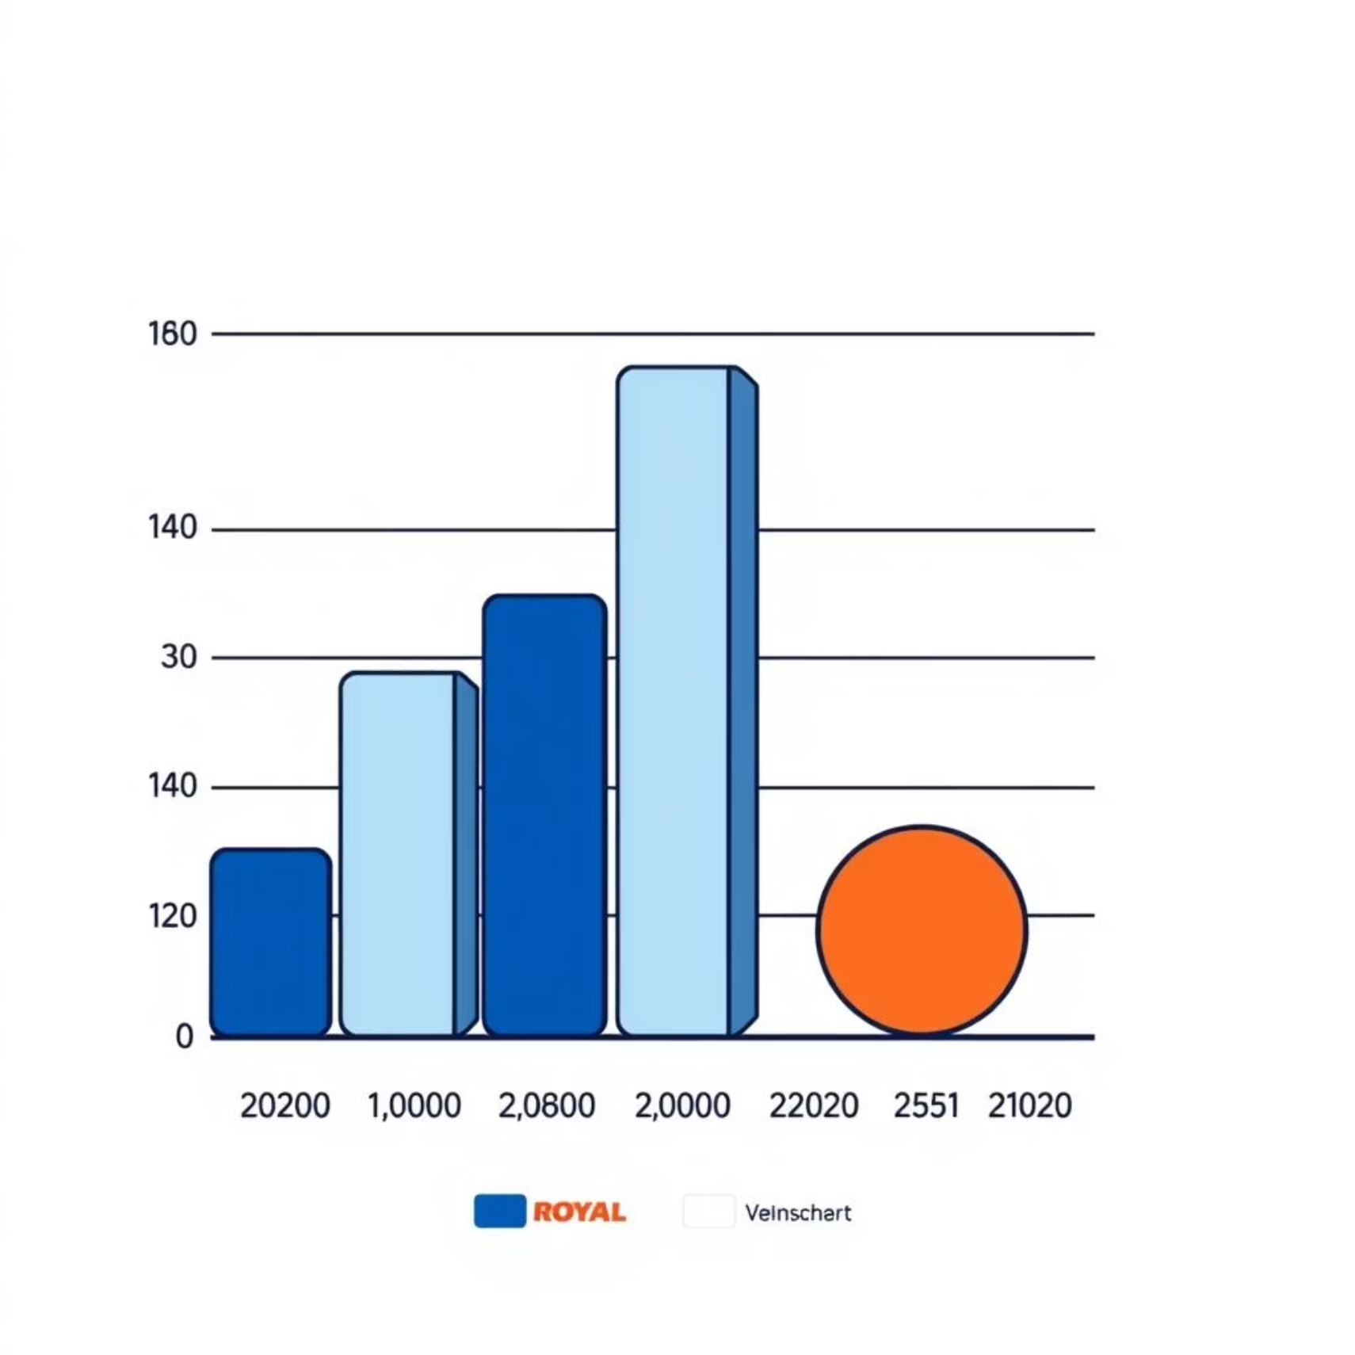
Univariate Analysis: Delving into Individual Features
Our initial exploration began with a univariate analysis, examining each feature
in isolation to understand its unique distribution and characteristics.
Numerical Features
Transaction Amount: Histograms and density plots revealed the typical spending patterns, with a long tail indicating occasional high-value transactions.
Time: Analysis of transaction timestamps showed peak activity hours, which could be indicative of normal usage patterns versus potential fraud.
Categorical Features
Fraud/Not Fraud: A significant class imbalance was observed, with fraudulent transactions accounting for a very small percentage (0.17%) of the total dataset. This imbalance is critical for subsequent modelling phases.

Slide 9
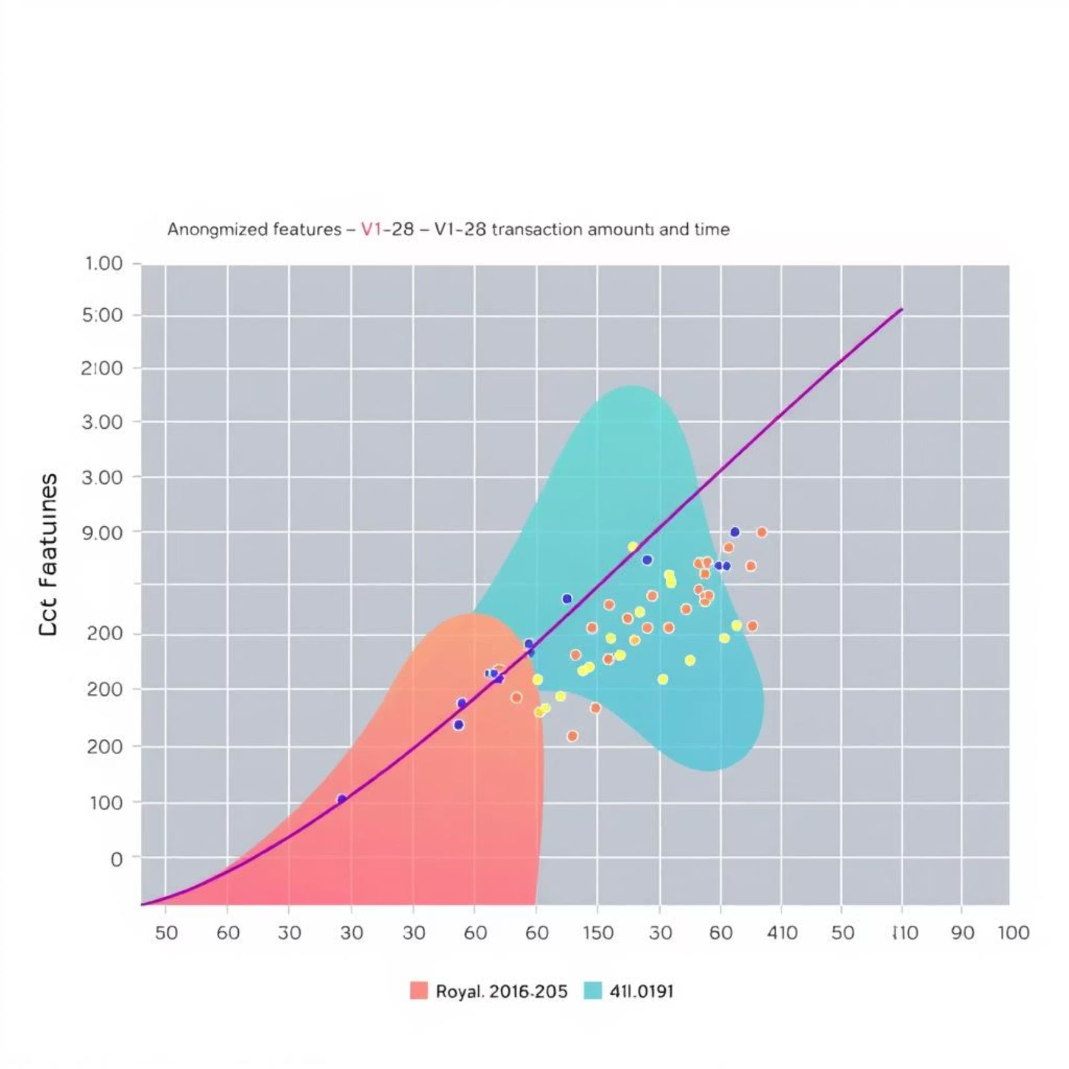
Bivariate Analysis: Uncovering Feature Relationships
Moving beyond individual features, bivariate analysis allowed us to investigate the interplay between different variables, especially their relationship with the fraud label.
Correlation Heatmaps
A correlation heatmap prominently displayed strong positive correlations between V2 and V5, and negative correlations between V7 and V20. These relationships offer initial clues into feature dependencies.
Visualising Distributions
Boxplots: Demonstrated how Transaction Amount varied across different categories, highlighting distinct patterns for fraudulent vs. legitimate transactions.
Scatterplots: Used to visualise the relationship between Transaction Amount and Time, revealing clusters or unusual patterns that might correlate with fraudulent activity.

Slide 10
Key Insights: What the Data Reveals
Our exploratory data analysis unearthed several crucial insights that will inform our approach to fraud detection and model development.
Fraudulent Signatures
Class Imbalance
High-Importance Features
Fraudulent transactions often exhibit significantly lower transaction amounts and occur outside typical business hours, particularly late at night or early morning. This suggests fraudsters might test cards with small purchases or exploit off-peak periods.
The dataset is heavily skewed, with legitimate transactions vastly outnumbering fraudulent ones. This severe class imbalance (approx. 0.17% fraud) necessitates specialised modeling techniques to prevent models from simply predicting the majority class.
Anonymised features like V14 and V17 demonstrated particularly high importance in distinguishing fraudulent from legitimate transactions. These features will be critical for developing accurate fraud detection models.

Slide 11

Addressing the Elephant in the Room: Class Imbalance
The most prominent challenge identified during EDA is the inherent class imbalance. This phenomenon, common in fraud detection datasets, poses significant hurdles for model training and evaluation.
With less than 0.2% of transactions being fraudulent, standard machine learning algorithms tend to classify nearly all transactions as legitimate, leading to high accuracy but poor recall for the minority (fraudulent) class.
Impact on Model Performance
Biased Learning: Models are trained predominantly on legitimate examples, causing them to neglect the patterns associated with rare fraudulent instances.
Misleading Metrics: High accuracy scores can be deceptive; a model that correctly predicts 99.8% of legitimate transactions but misses all fraud cases is useless.

Slide 12
Conclusion: A Robust Foundation for Future Fraud Detection
Our comprehensive Exploratory Data Analysis (EDA) of the credit card transaction dataset has laid a robust foundation for advanced fraud detection capabilities.
Data Mastery Achieved
Patterns Unveiled
Prepared for Action
We've gained a deep understanding of the dataset's distribution, characteristics, and intricate feature relationships.
Key patterns indicative of fraudulent activities have been identified, offering valuable insights for model development.
The dataset is now meticulously cleaned, preprocessed, and ready for the next phase: building powerful predictive models.

Slide 13

Question & answer
Thank you for your attention.

